Slide 1

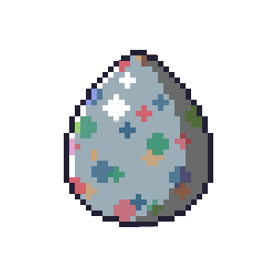
Assignment 3
Group 03

Slide 2

Goals and Motivation
Game
Virtual pet
Main target: kids of the age 15 and under
Sub-group: pixel art enthusiasts (nostalgic game)
Purpose:
Enjoyment
Motivation to go outside
Responsibility

Slide 3

Design and thoughts behind design
Simple design
Visually pleasing
Pixel art
Small animations

Slide 4
Main tools
Github
Android Studio (Java)
Aseprite
SQLite

Slide 5
Demonstration
Live demonstration
Notification
Lightsensor
Swipe
Stepcounter (GPS)

Slide 6
Strength and Weeknesses
+ Pixel Art
+ Easy to understand
- Swipe function not visible in the UI
- slow
- Not finished

Slide 7
Testing
beta-testing
Logic mostly visible in UI

Slide 8
Outlook for future plans
We had a lot of ideas:
extra meter hygiene
global scoreboard
different pets
supplies (toys/food) found by the pet walking outside
cleaning feature
…
Not ready for release

